Slide 1
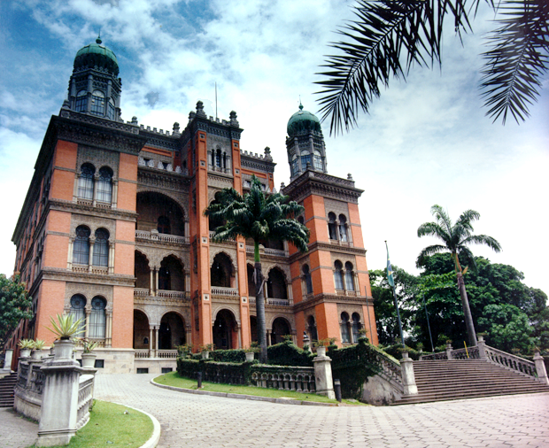
Self-testing, communication and information technology to promote HIV diagnosis among young gay and other men who have sex with men (MSM) in Brazil
Valdiléa G. Veloso, MD, PhD
Evandro Chagas National Institute of Infectious Diseases
Oswaldo Cruz Foundation – Brazil
IAS 2018, Amsterdam

Slide 2
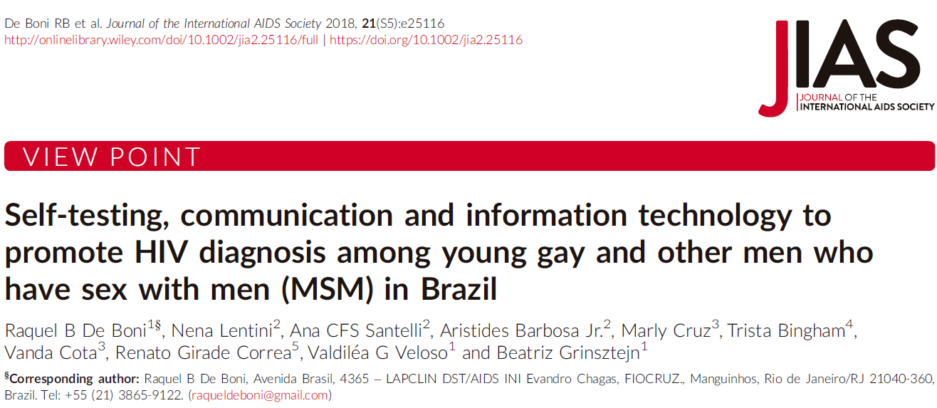

Slide 3
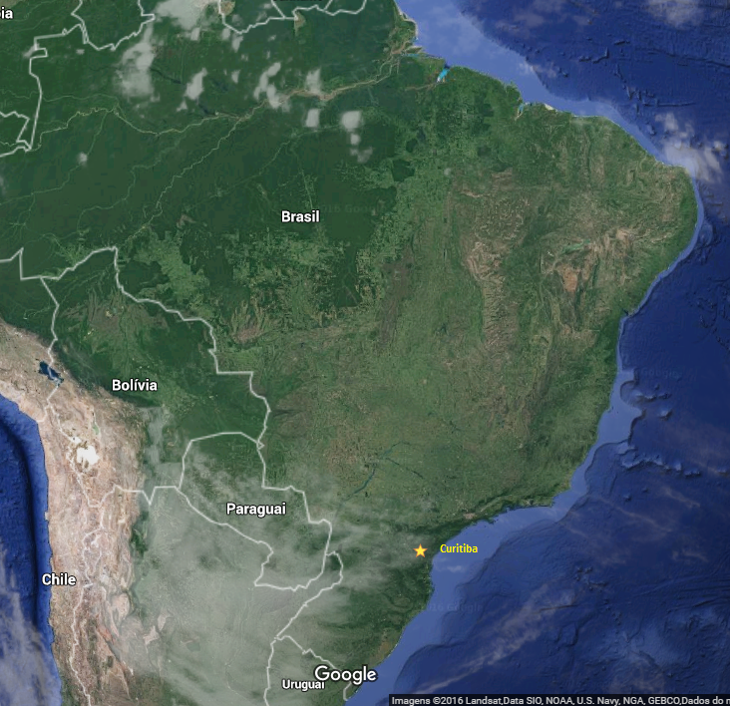
Background
Socio-structural factors are crucial to understand the low HIV testing uptake in many countries, as MSM may fear or may have experienced lack of privacy, confidentiality breaches and healthcare staff mistreatment
In Brazil, annual HIV testing by MSM increased from 21.2% (2009) to 43.9% (2016) → not enough
Curitiba
1.75 million inhabitants
19.9% (95%CI: 14.2-27.2) HIV prevalence among MSM
High level of homophobia
Brazilian MoH 2017. Kerr et al 2018; Guimarães et al. 2018

Slide 4
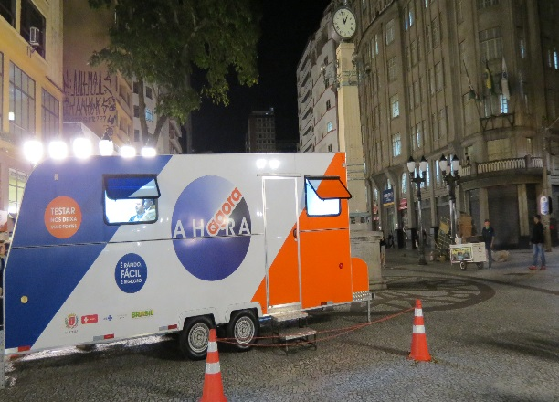
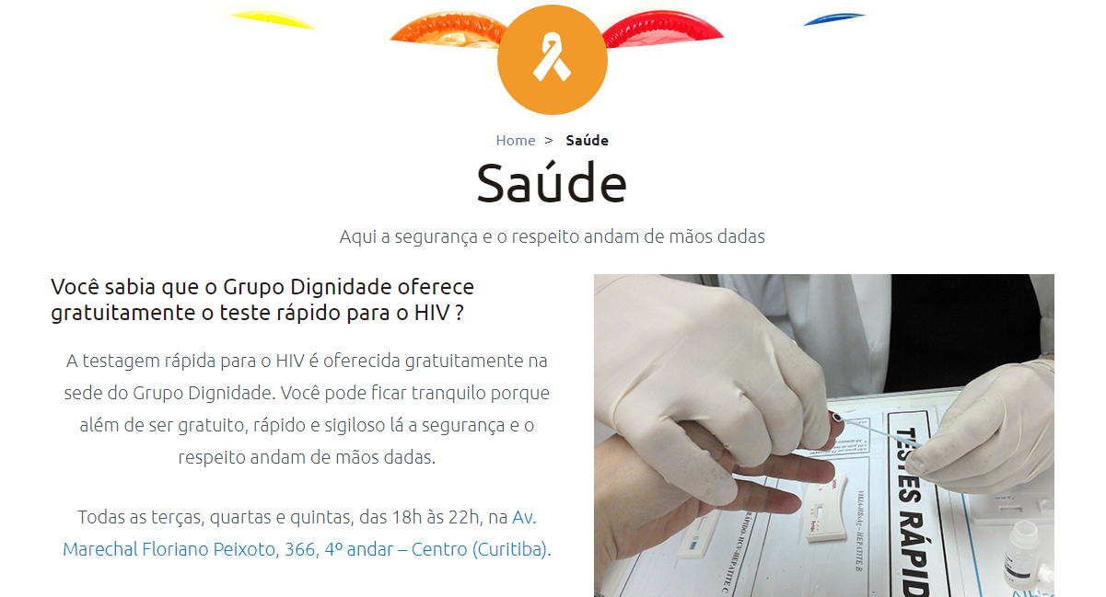
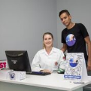
A HORA É AGORA (Time is now)
Community-wide intervention to increase HIV testing and linkage to care among MSM in Curitiba
Web-based HIV self-testing (“E-testing”) - From 2015 to 2017
Mobile testing (2 vans)
Testing in a LGBT NGO
Testing in a public voluntary and counseling testing service (VCT)
Steering Committee: SMS Curitiba, Department of STI/AIDS Brazilian MoH, FIOCRUZ, CDC Brazil and NGO Grupo Dignidade

Slide 5
A HORA É AGORA (Time is now)
E-testing
To develop, implement and evaluate the feasibility of a Web-based intervention that
Promotes HIV prevention
Provides free anonymous HIVST
Promotes linkage to care
Screening test
Recommended by the WHO as an additional HIV testing tool
Highly accepted and accurate

Slide 6
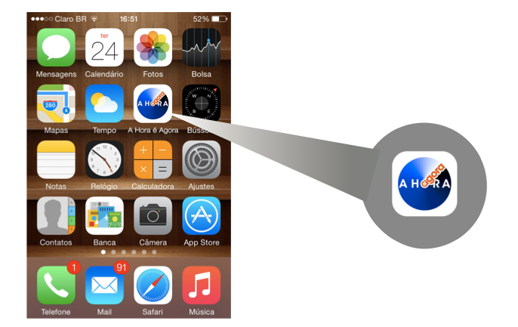
Website/app

Slide 7
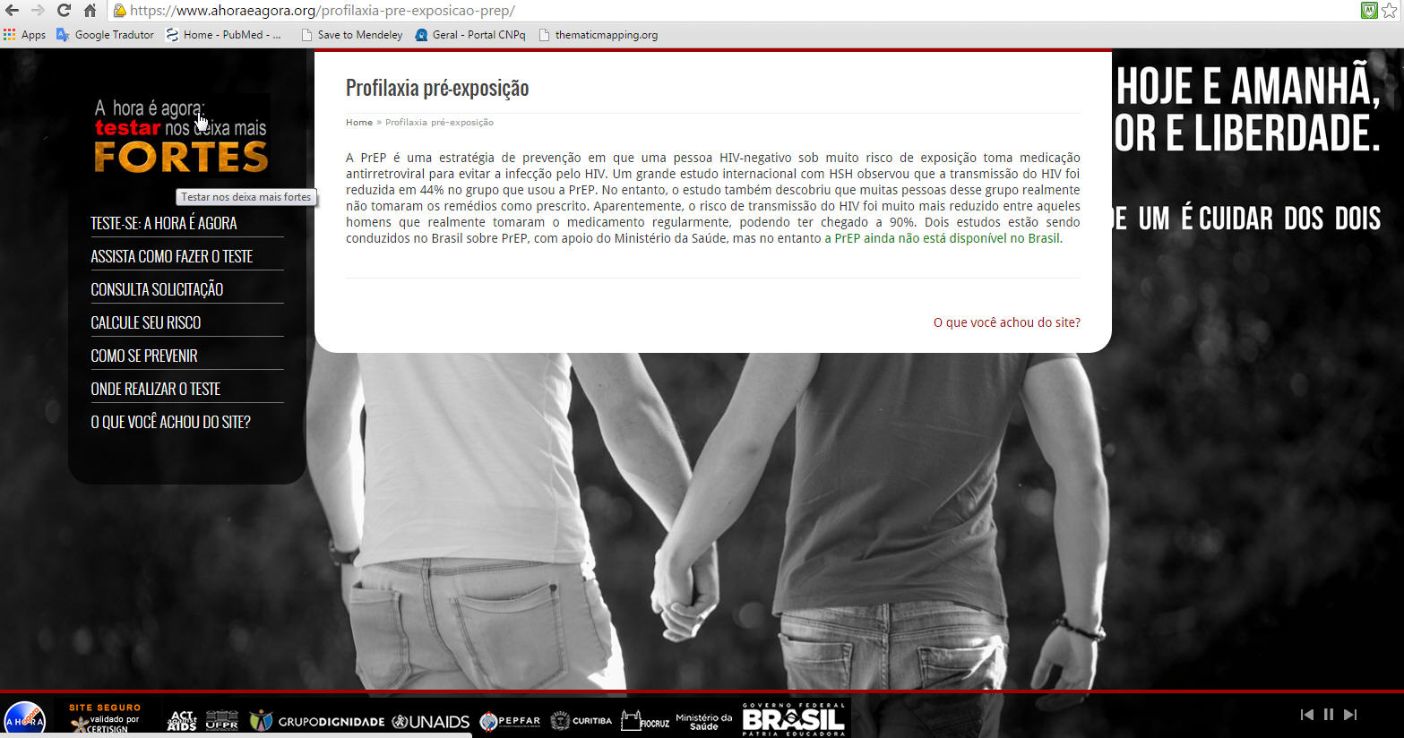
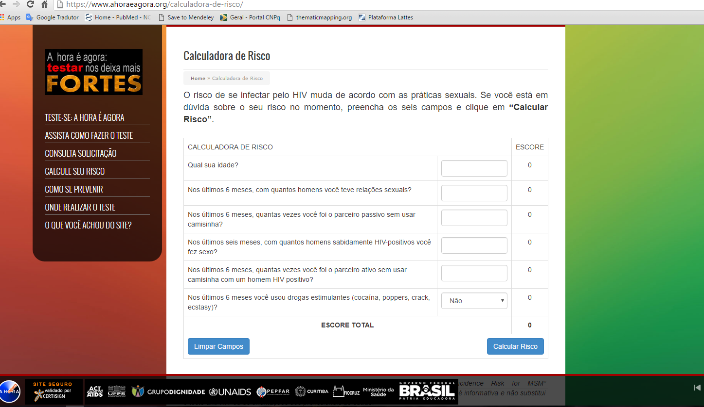
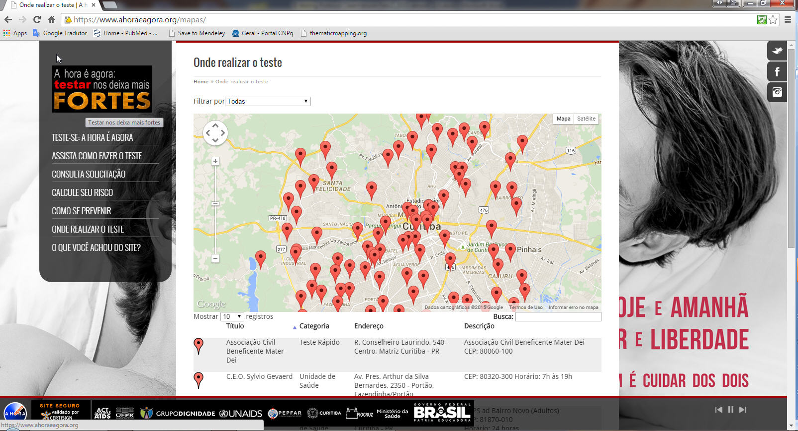
Website/app
Available at https://www.ahoraeagora.org/ and IOS and Android
5 modules: General information, HIVST request, Delivery, Administration and Monitoring
General information
HIV prevention
Self assesment of risk
Adapted from The HIV incidence Risk Index for MSM, CDC guideline for PrEP
HIV testing facilities

Slide 8
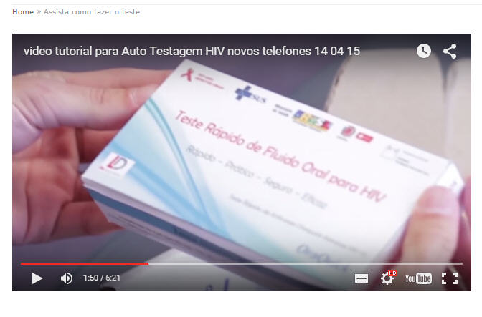
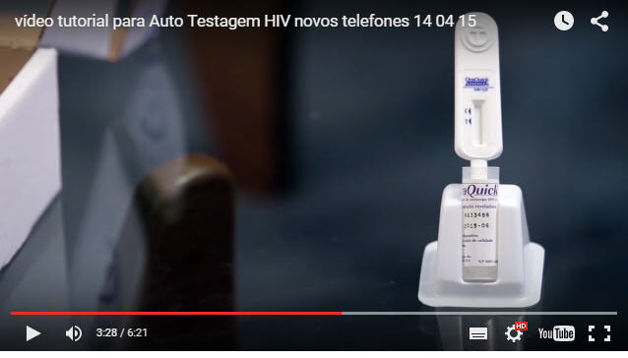
HIVST
HIVST kits
Oral fluid (OraQuick®) test
Two HIVST may be requested every 6 months
Supply of condoms and lubricants
Delivered by regular mail or to be retrieved in public pharmacy (anonymous)
Step-by-step video and written test instructions
24/7 hotline is available

Slide 9
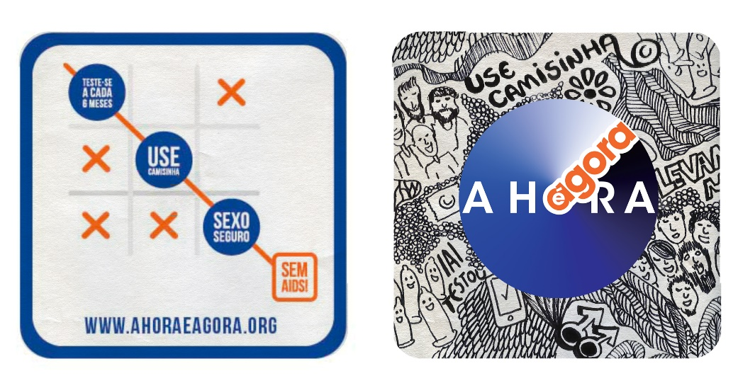
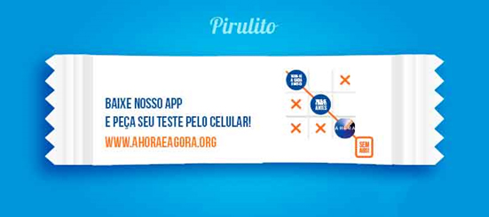
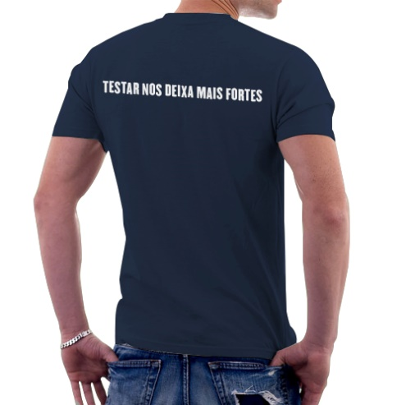
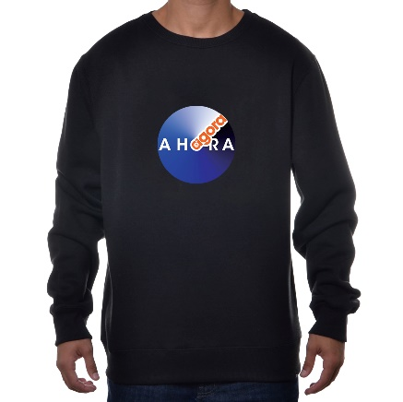
Communications Plan – the cornerstone
Drink coasters for bars
Lollipops
T-shirts

Slide 10
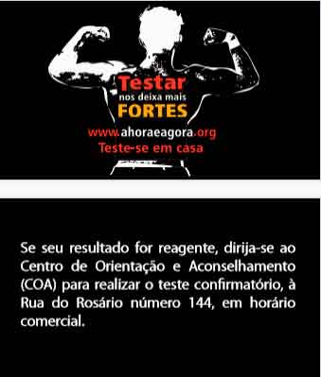
Communications Plan – the cornerstone
Pins and buttons
Card with location for
confirmatory HIV testing
Banners

Slide 11
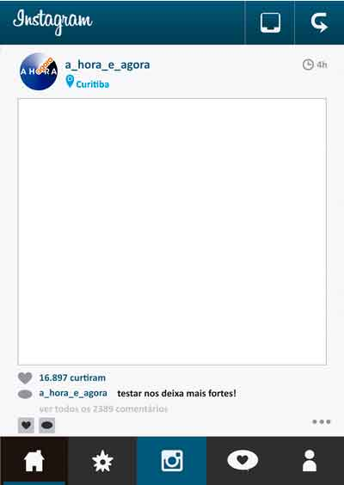
Communications Plan – the cornerstone
Frame Instagram
Cut out
Condom packaging

Slide 12
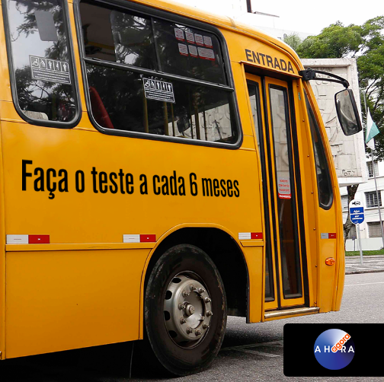
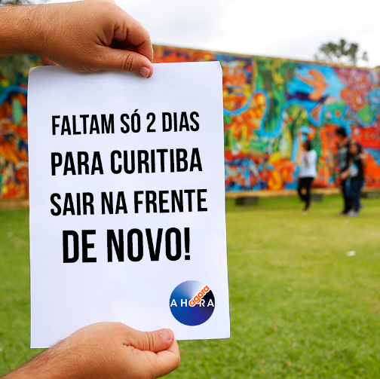
Communications Plan – the cornerstone
Post cards

Slide 13
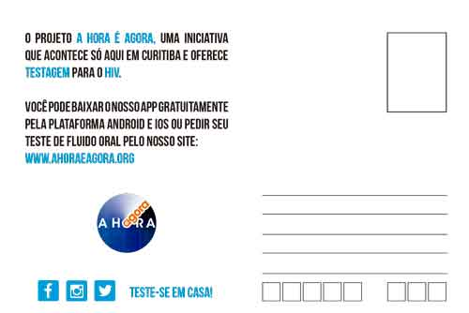
Communications Plan – the cornerstone
Campaigns on special dates
Valentine's Day

Slide 14
Communications Plan – the cornerstone
Videos in social media [17]

Slide 15
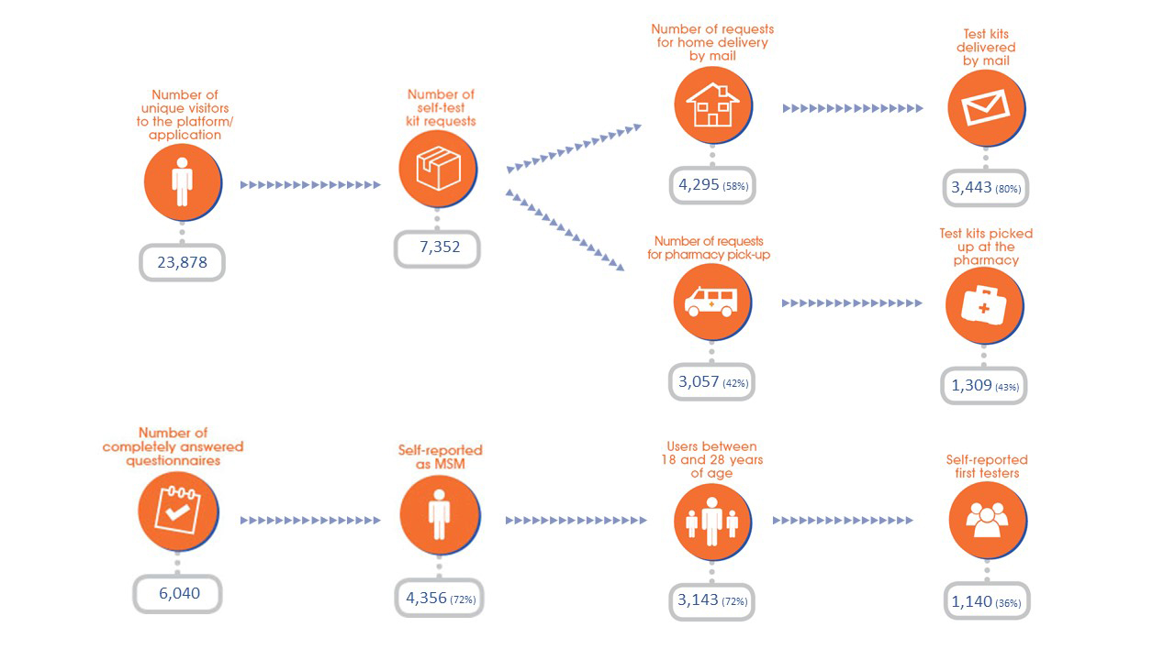
Web platform access and testing uptake – e-testing
A Hora É Agora Project, Curitiba (Brazil), 2015-2017

Slide 16
MSM testing for the first time – e-testing.
A Hora É Agora Project, Curitiba (Brazil), 2015-2017

Slide 17
Lessons Learned
Communication and information technologies are promising in attracting young MSM who value anonymity and privacy
Internet-based strategy to prevent HIV among MSM centered on HIVST is acceptable and feasible in Brazil
Highly educated MSM were the first to use the services
Reaching MSM with lower education and lower income may take more time
Useful for never-tested MSM and high-risk MSM who need frequent testing
Mail delivery is relatively costly
Lower HIVST kits pick up at public pharmacy in Curitiba
Political and structural changes during implementation
Major changes at “farmácia popular” (governmental program of public pharmacy)
Identification on mail delivery became mandatory

Slide 18
Next Steps
Scale up of e-testing in São Paulo
12 million inhabitants, highest HIV prevalence among MSM
Automated dispensers (vending machines) in MSM Gathering places instead of mail/pharmacy
Distribution Venues
Voluntary and Counseling Center
NGO Mobile units at night
HIV/AIDS Training and Referral Center
Diversidade Referral Center (CRD)
Vending Machines

Slide 19
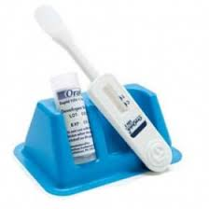
Next Steps
ImPrEP project
PrEP implementation project in Brazil, Mexico and Peru (7,500 MSM & TGW)
Funding: UNITAID & MoH of Brazil, Mexico and Peru
Evaluate secondary distribution in Brazil & Peru
Randomized Clinical Trial to evaluate the feasibility and effectiveness of HIVST secondary distribution by PrEP users to increase demand for HIV combination prevention among high risk MSM and TGW

Slide 20
Acknowledgments & Funding
INI- FIOCRUZ
Raquel B. De Boni
Beatriz Grinsztejn
Nilo Martinez Fernandes
Flavia Lessa
ENSP-FIOCRUZ
Marly Cruz
Vanda Cota
Secretaria Municipal de Curitiba
Juliane Oliveira
Cléa Elisa Ribeiro
Liza Rosso
Juliane C. Santos
Bernardo Almeida
Simone Muniz
Department of STI, AIDS and Viral Hepatitis - MoH
Renato Girade Correa
Renato Lima
João G.S. Netto
CDC Brasil
Aristides Barbosa
Nena Lentini
Ana CFS Santelli
Raquel Miranda
Leonardo Lincoln
CDC Atlanta
Trista Bingham
Grupo Dignidade
Toni Reis
Cooperative Agreement Number NU2G GH001152, funded by PEPFAR through CDC.
Contents are solely the responsibility of the authors and do not necessarily represent the official position of the funding agencies.

Slide 21
Obrigada!

